Slide 1

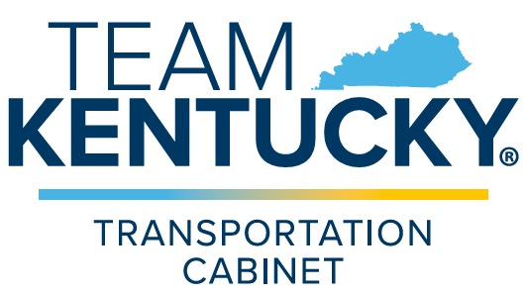
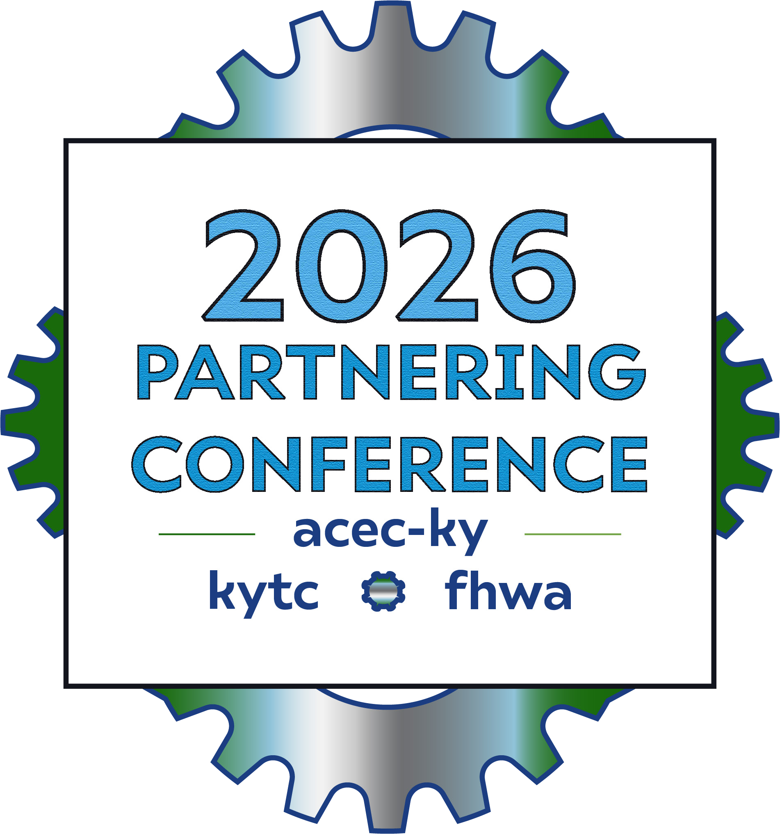
Communication During Project Development
Project Development Team Coordination for US 460 Widening/Reconstruction in Scott and Bourbon Counties

Slide 2


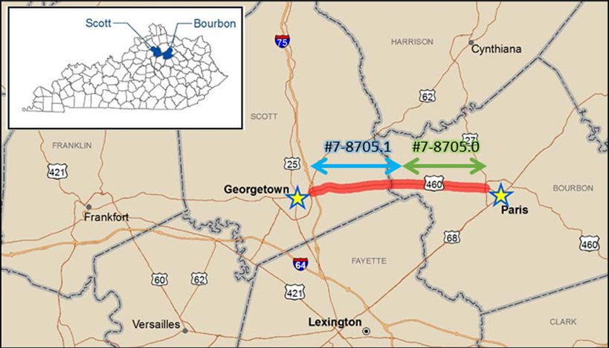
US 460 Reconstruction Overview (Scott & Bourbon Counties)
Project Scope & Extents:
  Covers US 460 in eastern Scott County and western Bourbon County, connecting I-75 in Georgetown to US27 in Paris.
  Phase Breakdown:
    7-8705.00: Centerville to Paris has been completed.
    7-80104.00: Active phase hopefully let to construction in early 2027.
Corridor Safety & Crash History (2014–2018 Data):
  178 total auto accidents recorded along the corridor.
  2 fatalities and 43 injury collisions.
  Crash severity exceeded County and State averages due to narrow lanes,
  lack of shoulders, and poor or non-existent roadside recovery zones.
Notes:
You all are looking at 5-10 minutes worth of speaking notes per slide, should be no problem using a lot of time up.
Photo of some sort down here, maybe a scale of the entire project

Slide 3

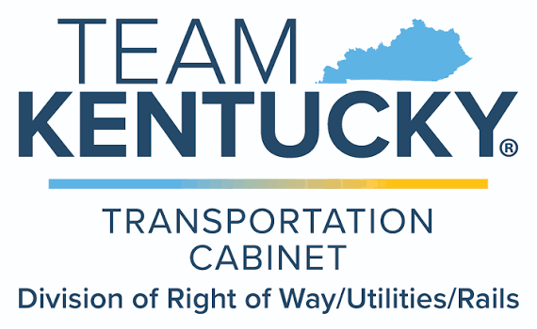
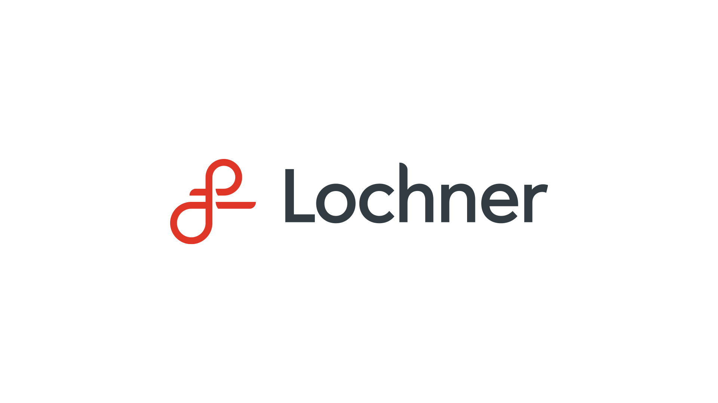

Parcel Acquisition Highlights:
  107 Total Parcels: One of the largest single project parcel counts for a KYTC District 7 project in nearly 25 years.
  62 Before & After Value Appraisals. Various complexity across entire project corridor
  2 Relocations managed as part of the acquisition process.
Notes:
Why didn’t KYTC do it all themselves?
General overview of what a project looks like when a consultant is involved and the scale that requires. This is your lead in to how the communication you all had was constructed and why it worked, and again, pretend you aren’t talking to a group of people who probably know the reasons already.

Slide 4
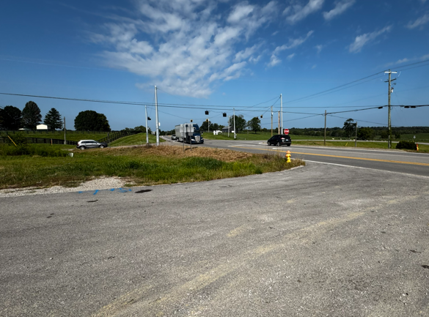
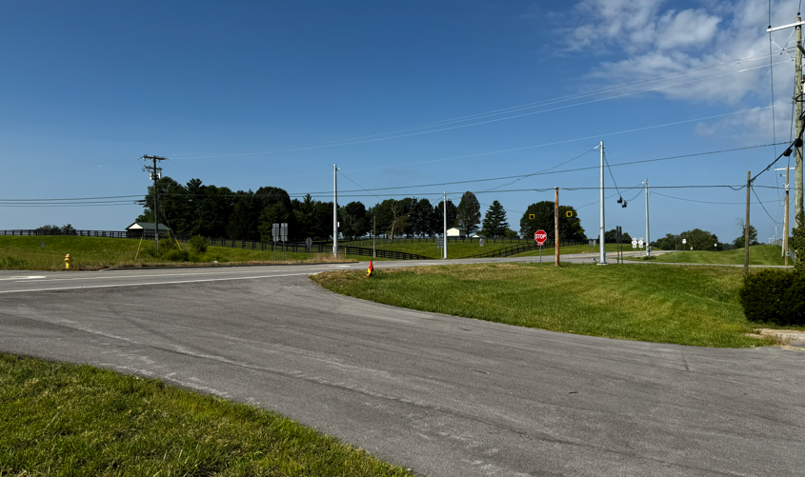
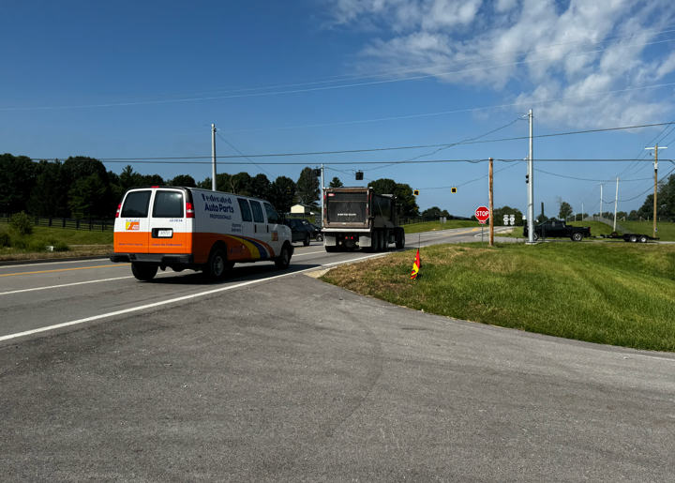
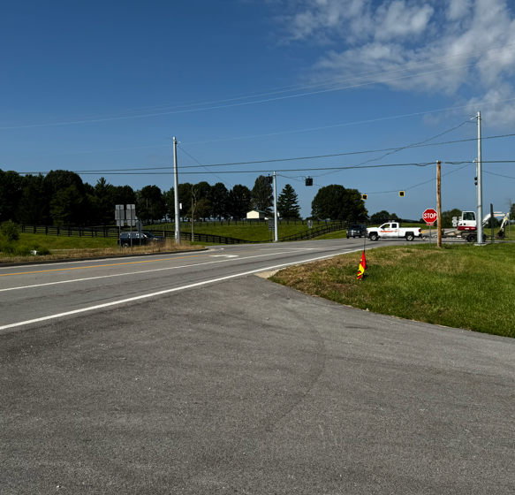
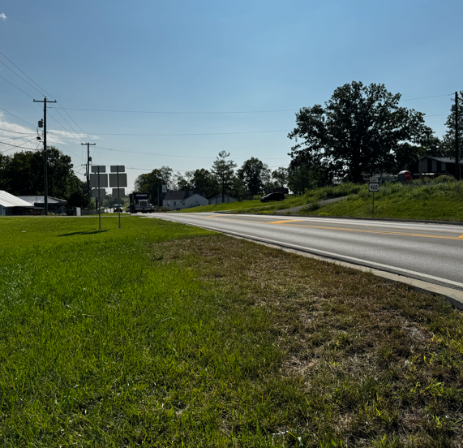
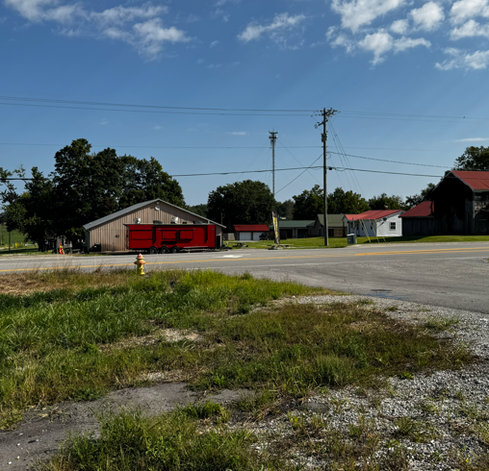

Slide 5
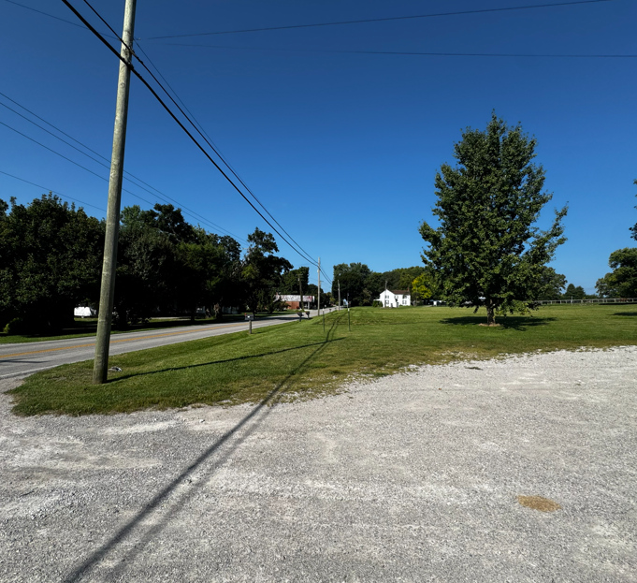
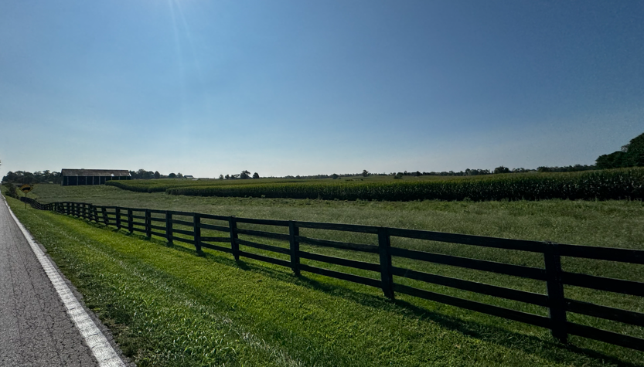
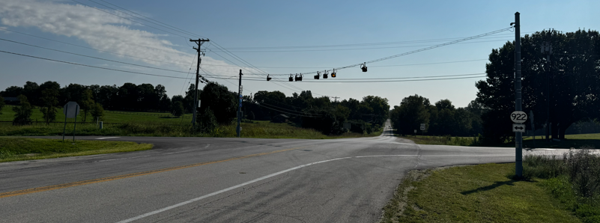

Slide 6
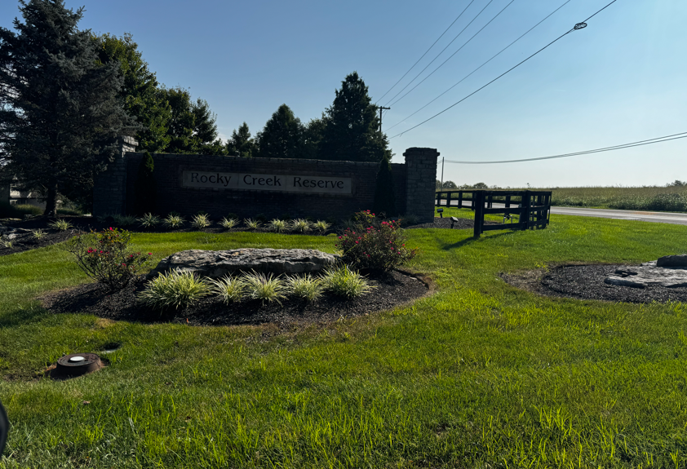
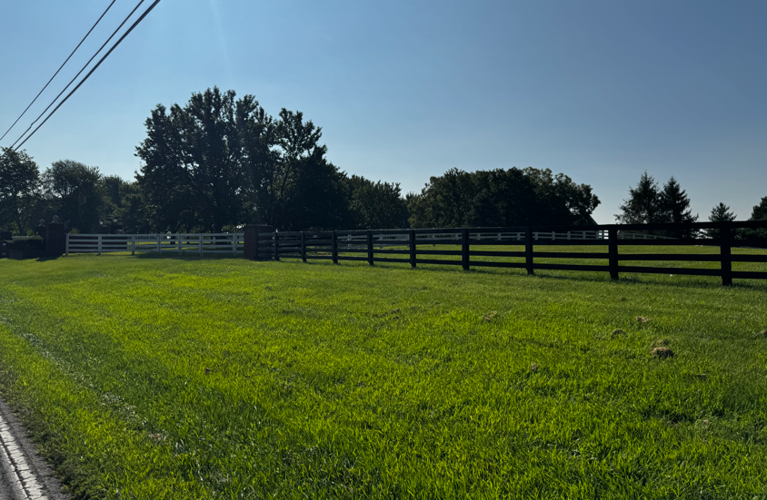
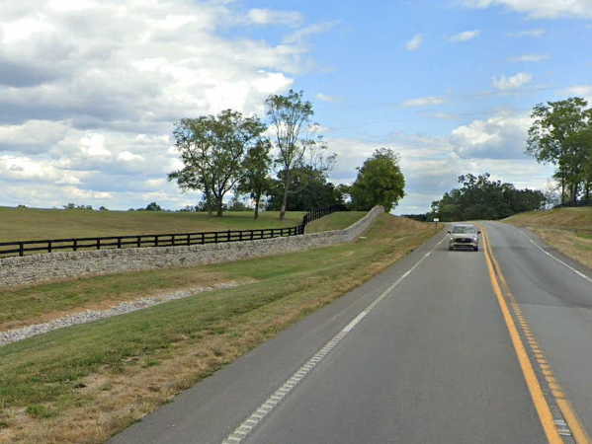
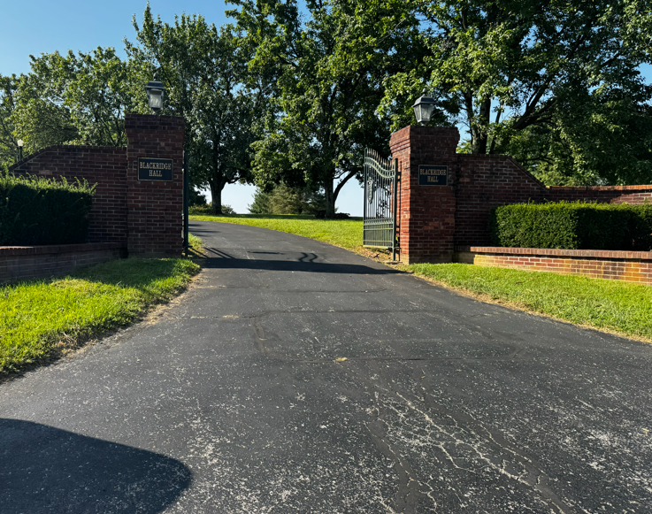
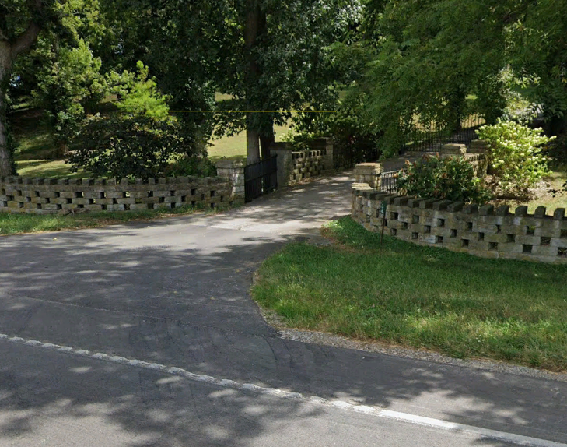

Slide 7



So, how’d we pull it off?
Think “Pizza Delivery” !
Gather requested plan changes
and settlement counter offers from property owners after each meeting in a “bundle”.
2. Meet every two weeks with the team in the beginning, lessened to once a month as offer meetings spread out.
3. Discuss requested plan changes with Design PM and Consultant PM.
4. Discuss potential settlement amounts with ROW staff after design issues are addressed to ensure confidentiality between owners and ROW.
Notes:
How’d you do it?
How a project of this scale is normally constructed, and explain it as if you weren’t talking to a room of people who have an idea of what that entails
Let’s meet, then meet some more, and then some more after that!
How often the team met, what they met about, why the meetings were structured in the way they were.
Standards that are normally followed but which had to be altered to accommodate a project this large.

Slide 8
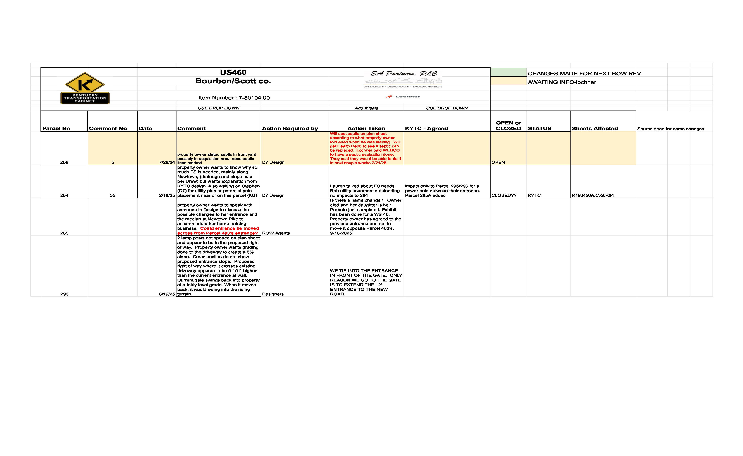
Example of ROW Status Checklist
Each parcel has a detailed note on what actions are requested and if that action has been denied, being processed, or been completed.

Slide 9


Addressing Property Owner Concerns
Entrance modification requests, elaborate entrance designs.
Additional landscaping.
Additional fencing for large farms.
Irrigation systems for businesses and cropland.
Business signage impacted by roadway.
Temporary Easements for construction that impact site improvements.
Any other unforeseen requests that may pop up.
Notes:
Challenges. Length of project from approval to letting, number of parcels, unique utility issues, specific odd property owner requests, etc
Unique problems with historic districts, rock walls, etc, anything that would get in the way of smooth completion aside from property owners themselves

Slide 10
Addressing Property Owner Concerns
Handling Common Landowner Questions:
  “How will the project impact my property?”
  “What if I don’t agree?”
  “How long will construction take?”
Key Contextual & Site-Specific Considerations:
  Access & Entrances: Maintaining access to commercial, residential, agricultural, and community sites (e.g., local churches, farm gates).
  Agricultural Needs: Accommodating specialized farm equipment and horse trailer maneuvering at entrances. Project is located in an area densely populated with large horse farms, unique to the Bluegrass region of Kentucky.
  Historic Preservation: Restoring and rebuilding traditional dry-stone masonry walls along right-of-way boundaries, as well as avoiding/maintaining historically significant parcels.
  Engineering Coordination: Utilizing detailed aerial CAD alignment overlays and site surveys to address specific owner concerns early.

Slide 11
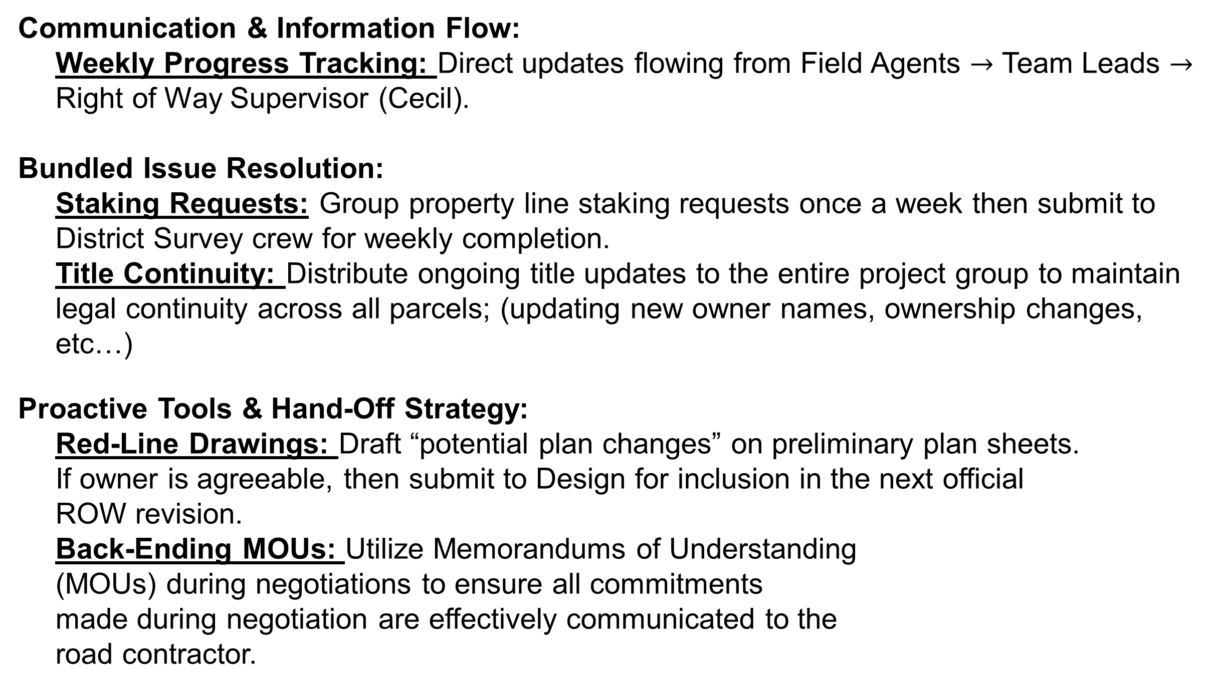
Managing Ongoing Issues During Execution
Communication & Information Flow:
  Weekly Progress Tracking: Direct updates flowing from Field Agents $→$ Team Leads $→$ Right of Way Supervisor (Cecil).
Bundled Issue Resolution:
  Staking Requests: Group property line staking requests once a week then submit to District Survey crew for weekly completion.
  Title Continuity: Distribute ongoing title updates to the entire project group to maintain legal continuity across all parcels; (updating new owner names, ownership changes, etc…)
Proactive Tools & Hand-Off Strategy:
  Red-Line Drawings: Draft “potential plan changes” on preliminary plan sheets.
  If owner is agreeable, then submit to Design for inclusion in the next official
  ROW revision.
  Back-Ending MOUs: Utilize Memorandums of Understanding
  (MOUs) during negotiations to ensure all commitments
  made during negotiation are effectively communicated to the
  road contractor.

Slide 12

Meet for drinks afterward!

